Slide 1
Chapter 7 Internet Protocol Version4 (IPv4)

Slide 2
Outline
Introduction
Datagram
Fragmentation
Options
Checksum
IP over ATM
Security
IP package

Slide 3
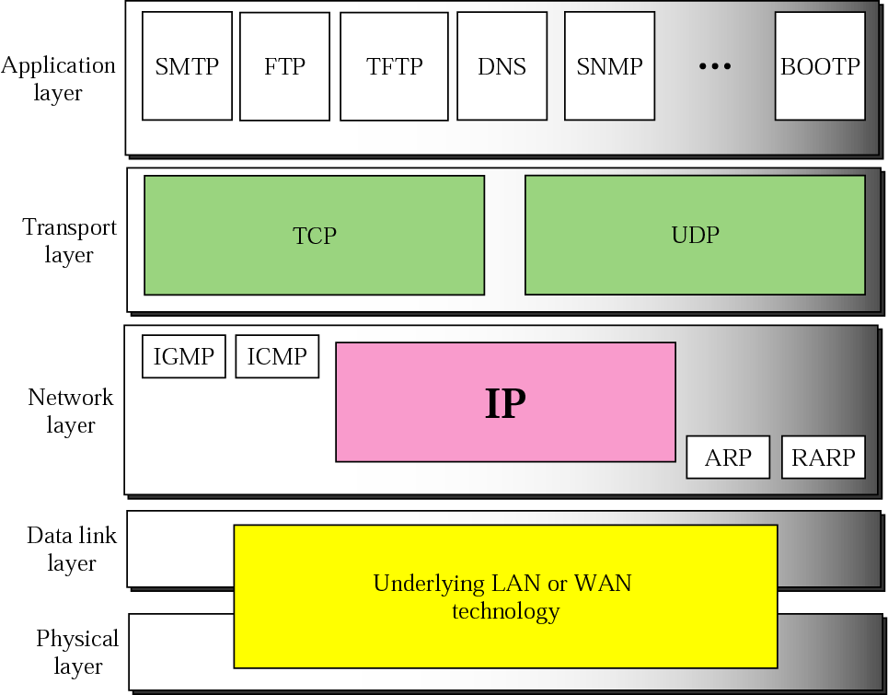
Figure 8-1
Position of IP in TCP/IP Protocol Suite
The McGraw-Hill Companies, Inc., 2000

Slide 4
IP: Internet Protocol
An unreliable and connectionless datagram protocol
A best-effort delivery service

Slide 5
Outline
Introduction
Datagram
Fragmentation
Options
Checksum
IP over ATM
Security
IP package

Slide 6
Datagram
Datagrams
Packets in the IP layers are called in datagrams
A variable-length packet
Consist of two parts
Header
Data

Slide 7
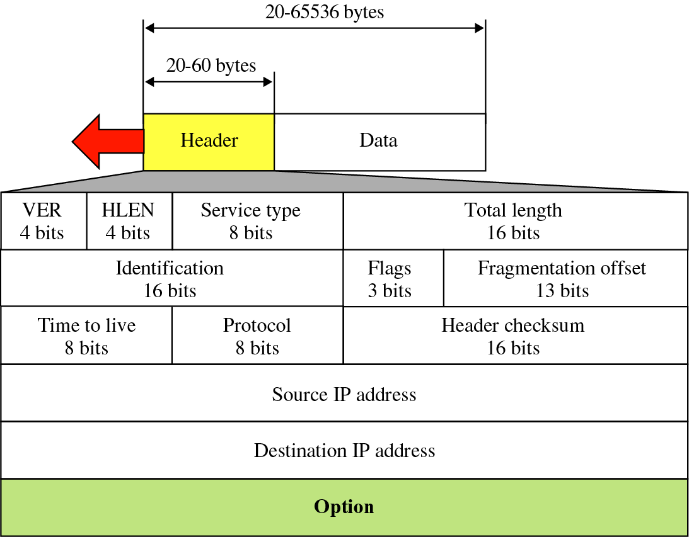
Figure 8-2
IP Datagram
The McGraw-Hill Companies, Inc., 2000

Slide 8
IP Datagram
Version (VER)
Header length (HLEN)
Length of the datagram header in 4-byte words
The length of the header is variable
20-60 bytes
If no options, header length is 20 bytes
HLEN = 5

Slide 9
IP Datagram (Cont.)
Service Type
In the original TCP/IP, this field was referred to as type of service (TOS)
IETF has recently changed the interpretation and name of this field, called differentiated services
See the following slides

Slide 10
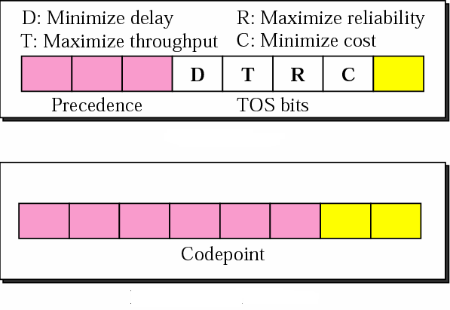
Figure 8-3
Type of Service v.s. Service Type
Type of Service
Differentiated Services
The McGraw-Hill Companies, Inc., 2000

Slide 11
Type of Service
Precedence
3-bit subfield defines the priority of the datagram in issues such as congestion
Datagrams with lowest precedence are discarded first
However, this subfield is not used in version 4
TOS (Type of Service) bits
4-bit subfield with each bit having a special meaning
However, one and only one of the bits can be set

Slide 12
Types of Services
TOS Bits | Description
0000 | Normal (default)
0001 | Minimize cost
0010 | Maximize reliability
0100 | Maximize throughput
1000 | Minimize delay

Slide 13
Default Types of Service
Protocol | TOS Bits | Description
ICMP | 0000 | Normal
BOOTP | 0000 | Normal
NNTP | 0001 | Minimize cost
IGP | 0010 | Maximize reliability
SNMP | 0010 | Maximize reliability
TELNET | 1000 | Minimize delay
FTP (data) | 0100 | Maximize throughput
FTP (control) | 1000 | Minimize delay
TFTP | 1000 | Minimize delay
SMTP (command) | 1000 | Minimize delay
SMTP (data) | 0100 | Maximize throughput
DNS (UDP query) | 1000 | Minimize delay
DNS (TCP query) | 0000 | Normal
DNS (zone) | 0100 | Maximize throughput

Slide 14
Default Types of Service (Cont.)
Minimum delay
Interactive activities
Activities requiring immediate attention
Activities requiring immediate response
Maximum throughput
Send bulk data
Maximum reliability
Management activities
Minimum monetary cost
Background activities, like Usenet News (NNTP)

Slide 15
Differentiated Services
The first 6 bits make up the codepoint
The last two bits are not used
The 3 right-most bits are 0s
The 3 left-most bits are interpreted the same as the precedence bits in the Service Type
The 3 right-most bits are not all 0s
The 6 bits define 64 services based on the priority assignment by the Internet or local authorities

Slide 16
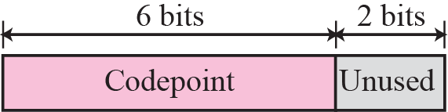
Service Type

Slide 17
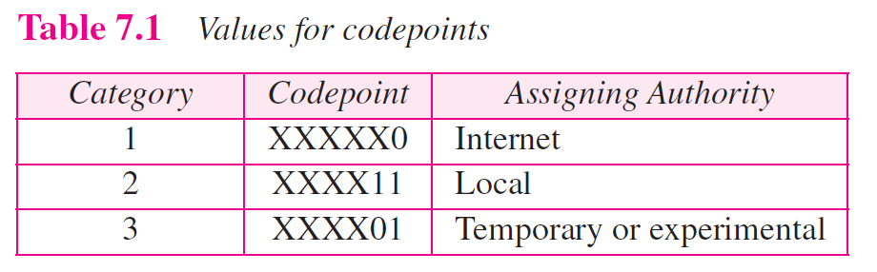
Values for Codepoints

Slide 18
Figure 8-2
IP Datagram
The McGraw-Hill Companies, Inc., 2000

Slide 19
IP Datagram (Cont.)
Total length
The total length (header plus data) of the IP datagram in bytes
Length of data = total length – header length
Identification
Used in fragmentation
Flags
Used in fragmentation
Fragmentation offset
Used in fragmentation

Slide 20
Figure 8-4
Encapsulation of a Small Datagram in an Ethernet Frame
Why we need the total length field
Layer 2 just drop the header and trailer
The remaining is the datagram (length)
However, in some cases, padding is occurred
Ethernet’s minimum frame data length is 46 bytes
If size of the IP datagram is less than 46, some padding will be added
Thus, check the total length field to determine how much is really data
The McGraw-Hill Companies, Inc., 2000

Slide 21
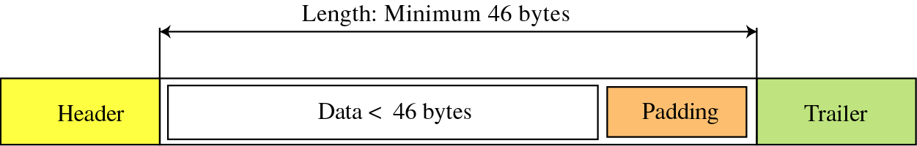
Encapsulation of a Small Datagram in an Ethernet Frame (Cont.)

Slide 22
IP Datagram (Cont.)
Time to live (TTL)
Defined the maximum number of hops visited by the datagram
When sending a IP datagram, source stores a value in TTL
Linux 2.4 kernel set this value to 255 (maximum value)
Windows XP set to128
When a router receives the datagarm
Decrement this number by one
After being decremented, if TTL == 0, discard this datagram
Why?
Routing table can become corrupted and datagram may loop in the Internet
Intentionally limit the journey of the packet
Protocol
Define the higher-level protocol that uses the services of the IP layer
Help in the demulplexing proccess

Slide 23
Protocols
Value | Protocol
1 | ICMP
2 | IGMP
6 | TCP
17 | UDP
89 | OSPF

Slide 24
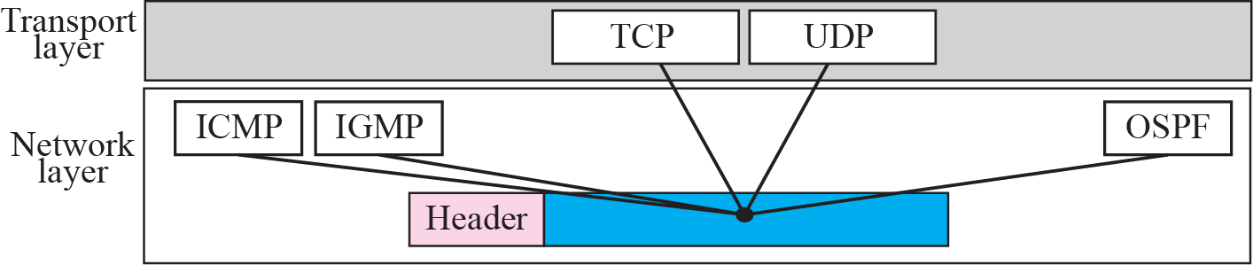
Figure 8-5
DeMultiplexing
The McGraw-Hill Companies, Inc., 2000

Slide 25
IP Datagram (Cont.)
Checksum
Source address
Define the IP address of the source
Never changed between the trip
Destination address
Define the IP address of the destination
Never changed between the trip

Slide 26
Figure 8-2
IP Datagram
The McGraw-Hill Companies, Inc., 2000

Slide 27
Example 7.1
An IP packet has arrived with the first 8 bits as shown:
⬅ 01000010
The receiver discards the packet. Why?
The McGraw-Hill Companies, Inc., 2000

Slide 28
Solution
There is an error in this packet
The 4 left-most bits (0100) show the version
which is correct
The next 4 bits (0010) show the header length
which means (2 × 4 = 8), which is wrong
The minimum number of bytes in the header must be 20
The packet has been corrupted in transmission

Slide 29
Example 7.2
In an IP packet, the value of HLEN is 1000 in binary. How many bytes of options are being carried by this packet?
The McGraw-Hill Companies, Inc., 2000

Slide 30
Solution
The HLEN value is 8
The total number of bytes in the header is 8 × 4 or 32 bytes
The first 20 bytes are the main header
The next 12 bytes are the options.

Slide 31
Example 7.3
In an IP packet, the value of HLEN is 5₁₆ and the value of the total length field is 0028₁₆. How many bytes of data are being carried by this packet?
The McGraw-Hill Companies, Inc., 2000

Slide 32
Solution
The HLEN value is 5
the total number of bytes in the header is 5 × 4 or 20 bytes (no options)
The total length is 40 bytes
The packet is carrying 20 bytes of data (40-20)

Slide 33
Example 7.4
An IP packet has arrived with the first few hexadecimal digits as shown below:
⬅ 45000028000100000102...................
How many hops can this packet travel before being dropped? The data belong to what upper layer protocol?
The McGraw-Hill Companies, Inc., 2000

Slide 34
Solution
To find the time-to-live field, we should skip 8 bytes (16 hexadecimal digits)
The time-to-live field is the ninth byte
Which is 01
The packet can travel only one hop
The protocol field is the next byte (02)
The upper layer protocol is IGMP

Slide 35
Outline
Introduction
Datagram
Fragmentation
Options
Checksum
IP over ATM
Security
IP package

Slide 36
Maximum Transfer Unit (MTU)
Each data link layer protocol has its own frame format
One of this field defines the maximum size of the data field
The maximum length of the IP datagram
65,536 bytes
Fragmentation
We must divide the IP datagram to make it possible to pass through the underlying network

Slide 37

Figure 8-6
MTU
The McGraw-Hill Companies, Inc., 2000

Slide 38
MTUs for Different Networks
Protocol | MTU
Hyperchannel | 65,535
Token Ring (16 Mbps) | 17, 914
Token Ring (4 Mbps) | 4, 464
FDDI | 4, 352
Ethernet | 1, 500
X.25 | 576
PPP | 296

Slide 39
Fragmentation
When a IP datagram is fragmented
Each fragment has its own IP header
Most of the fields repeated but some changed
A fragmented datagram may itself be fragmented
A datagram can be fragmented several times

Slide 40
Fragmentation (Cont.)
A datagram can be fragmented by the source host or any router in the path
However, the reassembly is done only by the destination host
Each fragment becomes an independent datagram, and thus may go through different paths

Slide 41
Fragmentation (Cont.)
When a datagram is fragmented
Router must change the values of three fields
Flags, fragmentation offset, and total length
Option field may or may not be copied
The value of checksum must be recalculated regardless of fragmentation

Slide 42
Figure 8-2
IP Datagram
The McGraw-Hill Companies, Inc., 2000

Slide 43
Fields Related to Fragmentation
Identification
16-bit field identifies a datagram originating from the source host
The combination of the identification and source IP address uniquely define a datagram
IP uses a counter to label the datagram
When fragmented, identification field is copied into all fragments
All fragments have the same identification number

Slide 44
Fields Related to Fragmentation (Cont.)
Flags: 3-bit field
1st bit: reserved
2nd bit: called do not fragment bit
1: do not fragment.
If cannot pass through the physical network, router discards the datagram and send an ICMP error message to the source
0: can be fragmented if necessary
3rd bit: called the more fragment bit
1: the datagram is not the last fragment
0: this is the last or only fragment

Slide 45

Figure 8-7
Flag Field
The McGraw-Hill Companies, Inc., 2000

Slide 46
Fields Related to Fragmentation (Cont.)
Fragmentation offset
The relative position of this fragment with respect to the whole datagram
Measured in units of 8 bytes
Thus, the first byte number of each fragment is divisible by 8

Slide 47
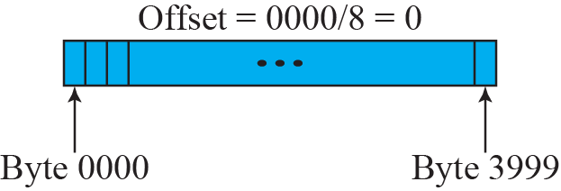
Figure 8-8
Fragmentation Example
The McGraw-Hill Companies, Inc., 2000

Slide 48
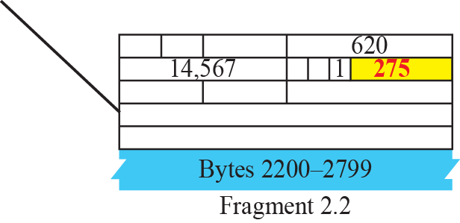
Figure 8-9
Detailed Example
The McGraw-Hill Companies, Inc., 2000

Slide 49
Reassembly
The first fragment has an offset value of zero
Divide the data length of the first fragment by 8
The second fragment has an offset value equal to that result
Divide the total length of the first and second fragment by 8
The third fragment has an offset value equal to that result
Continue the process until the last fragment has a more bit value 0

Slide 50
Example 7.5
A packet has arrived with an M bit value of 0. Is this the first fragment, the last fragment, or a middle fragment? Do we know if the packet was fragmented?
The McGraw-Hill Companies, Inc., 2000

Slide 51
Solution
If the M bit is 0
There are no more fragments
The fragment is the last one
However, we cannot say if the original packet was fragmented or not
A nonfragmented packet is considered the last fragment

Slide 52
Example 7.6
A packet has arrived with an M bit value of 1. Is this the first fragment, the last fragment, or a middle fragment? Do we know if the packet was fragmented?
The McGraw-Hill Companies, Inc., 2000

Slide 53
Solution
If the M bit is 1
There is at least one more fragment
This fragment can be the first one or a middle one, but not the last one
We don’t know if it is the first one or a middle one; we need more information
The value of the fragmentation offset
However, we can definitely say the original packet has been fragmented because the M bit value is 1

Slide 54
Example 7.7
A packet has arrived with an M bit value of 1 and a fragmentation offset value of zero. Is this the first fragment, the last fragment, or a middle fragment?
The McGraw-Hill Companies, Inc., 2000

Slide 55
Solution
The M bit is 1
Either the first fragment or a middle one.
The offset value is 0
It is the first fragment

Slide 56
Example 7.8
A packet has arrived in which the offset value is 100. What is the number of the first byte? Do we know the number of the last byte?
The McGraw-Hill Companies, Inc., 2000

Slide 57
Solution
To find the number of the first byte
Multiply the offset value by 8
The first byte number is 800.
We cannot determine the number of the last byte unless we know the length of the data

Slide 58
Example 7.9
A packet has arrived in which the offset value is 100, the value of HLEN is 5 and the value of the total length field is 100. What is the number of the first byte and the last byte?
The McGraw-Hill Companies, Inc., 2000

Slide 59
Solution
The first byte number is 100 × 8 = 800
The header length is 20 bytes (5 × 4)
The total length is 100 bytes
There are 80 bytes in this datagram
If the first byte number is 800, the last byte number must 879

Slide 60
Outline
Introduction
Datagram
Fragmentation
Options
Checksum
IP over ATM
Security
IP package

Slide 61
Options Format
Type field: 1-byte
Length field: 1-byte
Total length of the option
Include the type field and the length field
Not present in all of the option types
Value field: variable-sized
Contain the data that specific option required
Not present in all option types
These three fields are often referred to as type-length-value or TLV

Slide 62
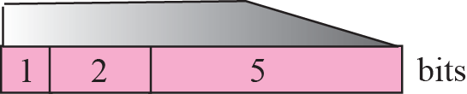
Figure 8-10
Option Format
The McGraw-Hill Companies, Inc., 2000

Slide 63
Type Field
Copy: 1-bit controls the presence of the option in fragmentation
0: the option only appear in the first fragment
1: the option appear in all fragments
Class: 2-bit defines the general purposes of the option
00: the option is used for datagram control
10: the option is used for debugging and management
01 and 11: have not yet been defined
Number: 5-bit defines the type of the option
only 6 types are in use

Slide 64
Option Types
Only 6 options are currently being used
Two of them are 1-byte option
Do not require the length or the value fields
Four of them are multiple-byte option
Require the length and the value fields

Slide 65
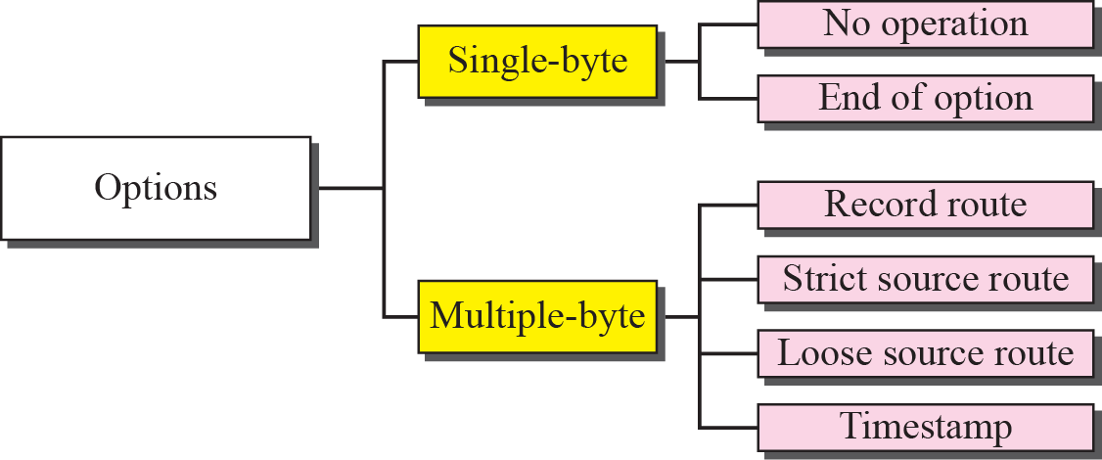
Figure 8-11
Categories of Options
The McGraw-Hill Companies, Inc., 2000

Slide 66
Figure 8-2
IP Datagram
The McGraw-Hill Companies, Inc., 2000

Slide 67
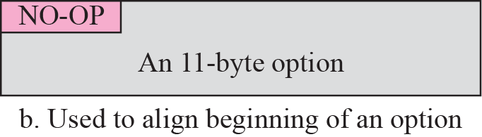
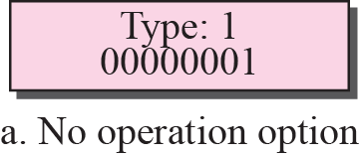
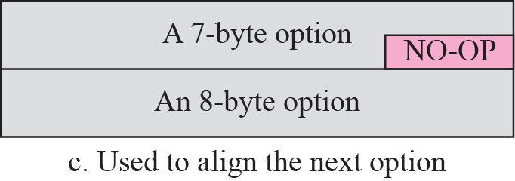
No-Operation Option
Used as a filler between options
For example, used to align the next option on a 16-bit or 32-bit boundary

Slide 68
End-of-Option Option
Used for padding at the end of the option field
Can only be used as the last option
Only one end of option option can be used
After this option
The receiver check for the payload data
Thus, if more than 1 byte is needed to align the option field
Some no operation options must be used followed by an end of option option

Slide 69
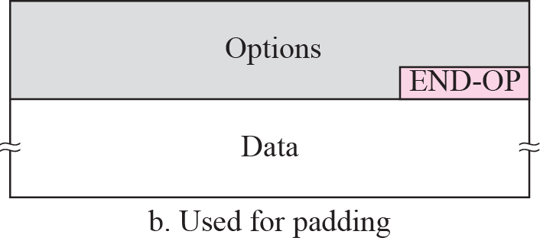
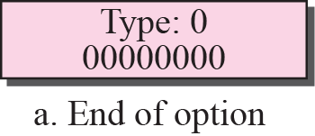
End-of-Option Option (Cont.)

Slide 70
Record-Route Option
Used to record the routers that handle the datagram
Can list up to nine router IP address since the maximum size of option part in an IP header is 40 bytes
Pointer: an offset integer field containing the byte number of the first empty entry
Point to the first available entry

Slide 71
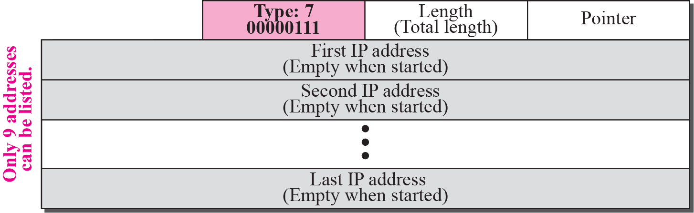
Figure 8-14
Record-Route Option
The McGraw-Hill Companies, Inc., 2000

Slide 72
Record-Route Option (Cont.)
Initially the pointer field has a value of 4
When receiving this datagram, the router
Insert its outgoing IP address in the empty field
Increment the value of the pointer by 4

Slide 73
Figure 8-15
Record-Route Concept
The McGraw-Hill Companies, Inc., 2000

Slide 74
Strict-Source-Route Option
Used by the source to predetermine a route for the datagram
Rule
All the routers defined in the option must be visited
A router must not be visited if its IP address is not listed in the datagram

Slide 75
Strict-Source-Route Option (Cont.)
If the datagram visits a router not on the list
Discard the datagram and issue an error message
If the datagram arrives at the destination and some of the entries were not visited
Discard the datagram and issue an error message

Slide 76
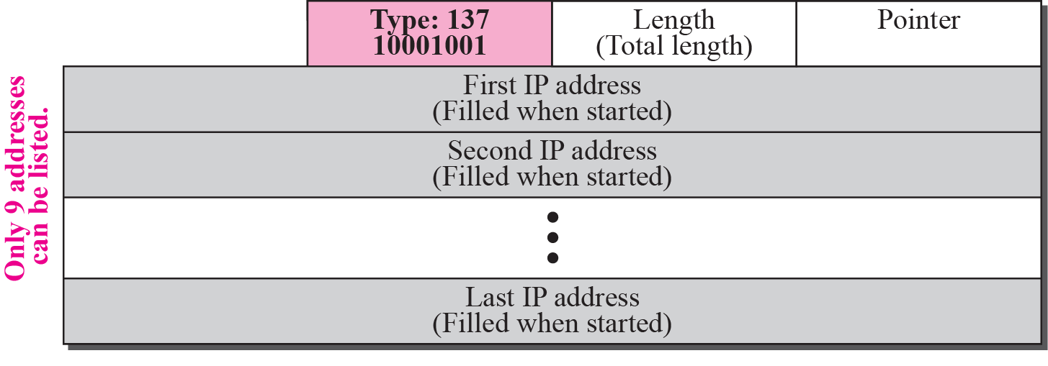
Figure 8-16
Strict-Source-Route Option
The McGraw-Hill Companies, Inc., 2000

Slide 77
Strict-Source-Route Operations
When a datagram arriving at a router, compare the pointer value with the length field
If pointer <= length, compare the IP address pointed by the pointer with its incoming IP address
If equal,
Process the packet
Overwrite the current IP address with its incoming IP address
Increment the pointer by 4
Forward the packet
If not equal, discard the datagram and issue an error message
If pointer > length, discard the datagram and issue an error message

Slide 78
Strict-Source-Route Concept

Slide 79
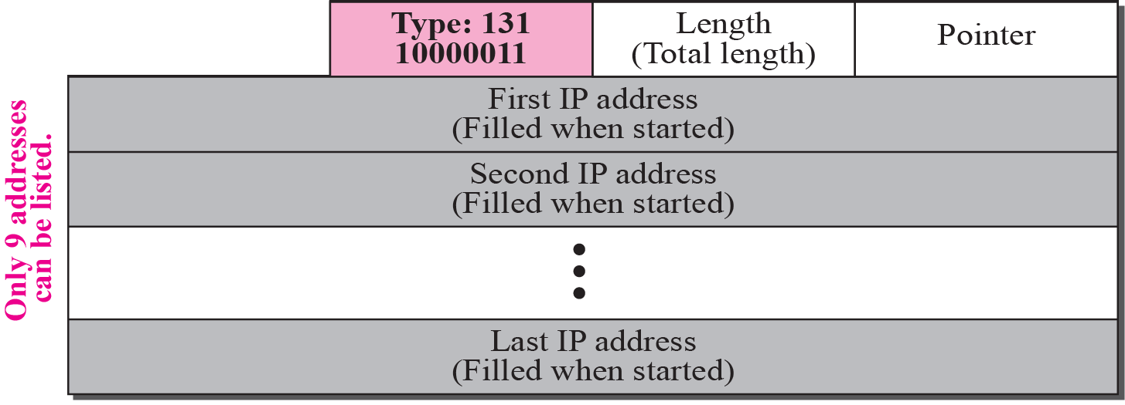
Loose-Source-Route Option
Each router in the list must be visited
But the datagram can visit other routers as well

Slide 80
Timestamp
Used to record the time of datagram processing by a router
Expressed in millisecond from midnight, Universal Time
Help to track the behavior of the router

Slide 81
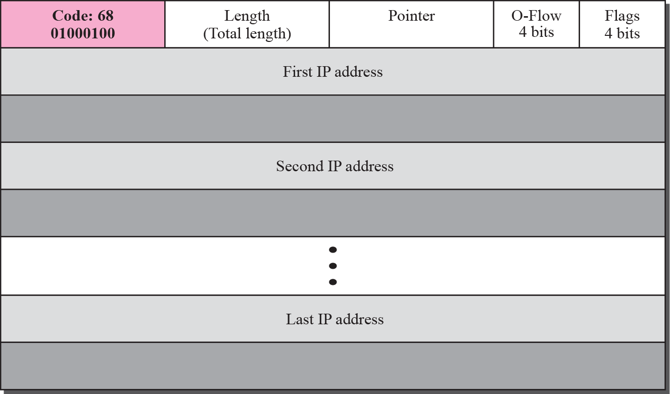
Figure 8-19
Timestamp Option
The McGraw-Hill Companies, Inc., 2000

Slide 82
Timestamp Option Format
Overflow field
The number of routers that could not add their timestamp because no more fields were available
Flag: the visited router responsibilities
0: each router add only timestamp in the provided field
1: each router add its outgoing IP address and timestamp
3: the IP address are given. Each router check the given IP address with its own incoming IP address
If match, overwrite with its outgoing IP address and add timestamp

Slide 83
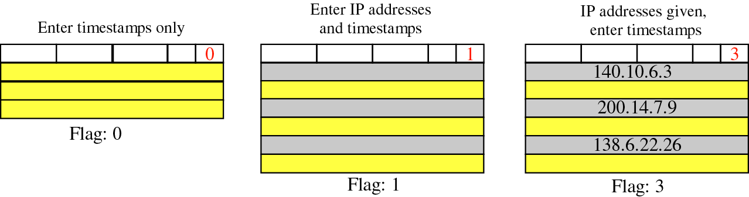
Figure 8-20
Use of Flag in Timestamp
The McGraw-Hill Companies, Inc., 2000

Slide 84
Figure 8-21
Timestamp Concept with Flag Value of 1
The McGraw-Hill Companies, Inc., 2000

Slide 85
Example 7.10
Which of the six options must be copied to each fragment?
The McGraw-Hill Companies, Inc., 2000

Slide 86
Solution
Look at the first (left-most) bit of the code for each option
No operation: Code is 00000001; no copy.
End of option: Code is 00000000; no copy
Record route: Code is 00000111; no copy
Strict source route: Code is 10001001; copied
Loose source route: Code is 10000011; copied
Timestamp: Code is 01000100; no copy

Slide 87
Example 7.11
Which of the six options are used for datagram control and which are used for debugging and management?
The McGraw-Hill Companies, Inc., 2000

Slide 88
Solution
Look at the second and third (left-most) bits of the code
No operation: Code is 00000001; control
End of option: Code is 00000000; control
Record route: Code is 00000111; control
Strict source route: Code is 10001001; control
Loose source route: Code is 10000011; control
Timestamp: Code is 01000100; debugging

Slide 89
Example 7.12
One of the utilities available in UNIX to check the travelling of the IP packets is ping.
Ping a server named fhda.edu and the result shows that the IP address of the host is 153.18.8.1

Slide 90
Example 7.13
We can also use the ping utility with the -R option to implement the record route option

Slide 91
Example 7.14
The traceroute utility can also be used to keep track of the route of a packet
The result shows the three routers visited.

Slide 92
Example 7.15
The traceroute program can be used to implement loose source routing.
The -g option allows us to define the routers to be visited, from the source to destination.
Following shows how we send a packet to the fhda.edu server with the requirement that the packet visit the router 153.18.251.4

Slide 93
Example 7.16
The traceroute program can also be used to implement strict source routing.
The -G option forces the packet to visit the routers defined in the command line.
Following shows how we send a packet to the fhda.edu server and force the packet to visit the router 153.18.251.4

Slide 94
Outline
Introduction
Datagram
Fragmentation
Options
Checksum
IP over ATM
Security
IP package

Slide 95
Checksum
Error detection method
Checksum calculation at the sender
The packet is divided into k section, each of n bits
All sections are added together using one’s complement arithmetic
The final result is complemented to make the checksum

Slide 96
補充:Addition in One's Complement
Addition of signed numbers in one's complement is performed using binary addition with end-around carry.
Add any resulting carry back into the resulting sum

Slide 97

補充:Addition in One's Complement (Cont.)
Add decimal 17 to decimal -8 in 8-bit one's complement:

Slide 98
Checksum (Cont.)
Checksum calculation at the receiver
Divides the received packet, including the checksum, into k section
Add all section and then complement the result
If the final result is 0, the packet is accepted
Otherwise, reject the packet

Slide 99
Figure 8-2
IP Datagram
The McGraw-Hill Companies, Inc., 2000

Slide 100
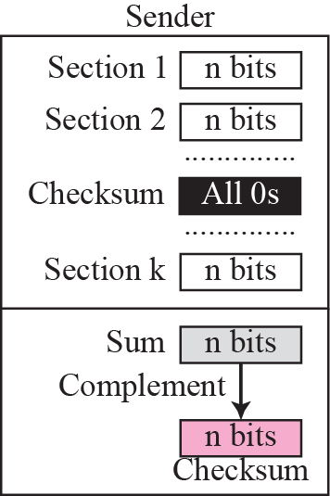
Figure 8-22
Checksum Concept
The McGraw-Hill Companies, Inc., 2000

Slide 101
Checksum Concept
According to the one’s complement arithmetic
If all the section are added and the number is T
Complement T in one’s complement is –T
Thus, if the sum is T, the checksum is –T
When the receiver receives the packet
T + (-T) in one’s complement is -0
Complement -0 derive 0
Thus, the final result should be 0

Slide 102
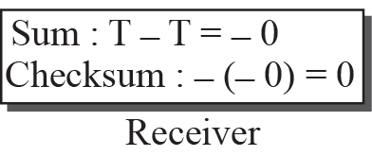
Figure 8-23
Checksum in One’s Complement Arithmetic
The McGraw-Hill Companies, Inc., 2000

Slide 103
Example:
T =01110101 (= 117)
-T=10001010 (= -127) = checksum
T+(-T) = 1111 1111 (= -0)
-(T+(-T))= 00000000 (=+0)

Slide 104
Checksum in the IP Packet
The checksum in the IP packet covers only the header, not the data. This is because
All higher-level protocols that encapsulate data in the IP datagram have a checksum field
Checksum for the IP datagram do no have to check the encapsulated data
The header of the IP datagram changes with each visited router, but the data does not
If the data is included, each router must recalculate the checksum including data

Slide 105
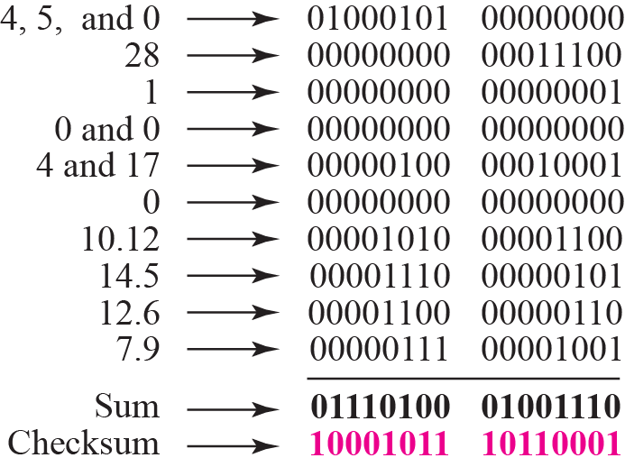
Example 7.17: Checksum Calculation in Binary

Slide 106
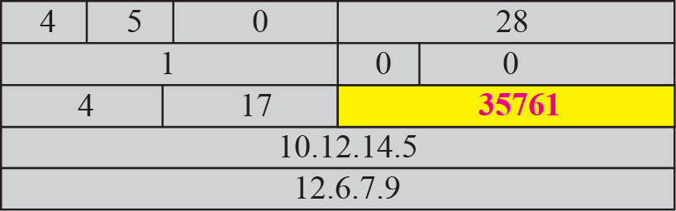
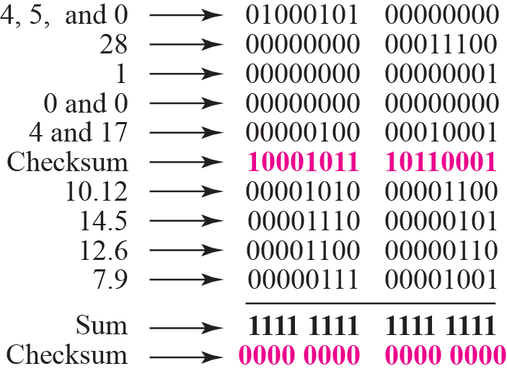
Example 7.18: Checksum Checking in Receiver

Slide 107
Outline
Introduction
Datagram
Fragmentation
Options
Checksum
IP over ATM (Skip!)
Security
IP package (Skip)

Slide 108
Security
No security was provided for the IPv4 protocol
The IPv4 was started when the Internet users trusted each other
However, today, the Internet is not secure any more
Security Issues
Packet Sniffing (嗅,聞) (偷看封包的內容)
Packet Modification
IP Spoofing (愚弄)

Slide 109
Packet Sniffing
An intruder intercepts an IP packet and make a copy of it
A passive attack
Since not change the contents of the packet
Very difficult to detect
Solution: encryption

Slide 110
Packet Modification
An intruder modifies the packet
Intercepts the packet, changes its contents, and sends the new packet to the receiver
Solution: data integrity

Slide 111
IP Spoofing
An attacker can masquerade(冒充) as somebody else and create an IP packet that carries the source address of another computer
Solutions: origin authentication

Slide 112
IPSec
The IP packet today can be protected by IPSec (IP Security) protocol
IPSec provides the following four services
Defining algorithms and keys
Packet encryption
Data integrity
Origin authentication

Slide 113
Outline
Introduction
Datagram
Fragmentation
Options
Checksum
IP over ATM (Skip!)
Security
IP package (Skip)

